Slide 1
FooCodeChu
Services for software analysis, malware detection, and vulnerability research
Silvio Cesare <silvio.cesare@gmail.com>

Slide 2
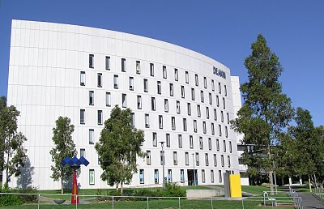
Who am I and why this talk?
Ph.D. Student at Deakin University
Book Author
This talk covers some of my publically accessible Ph.D. research.

Slide 3
Introduction
Research on software analysis, similarity, and classification
Malware detection and attribution
Incident response
Plagiarism detection
Software theft detection
Vulnerability research
Three academic research tools free to use on my website.

Slide 4
Outline
Simseer
Clonewise
Bugwise
Future Work and Conclusion

Slide 5
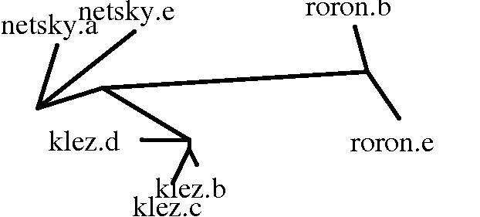
Simseer
Software similarity and visualisation

Slide 6
Motivation
Many applications of software similarity
Malware detection
Plagiarism detection
Software theft detection
Traditional string signatures are ineffective
Modern fingerprints effective but in many case inefficient

Slide 7
Program Representation

Slide 8
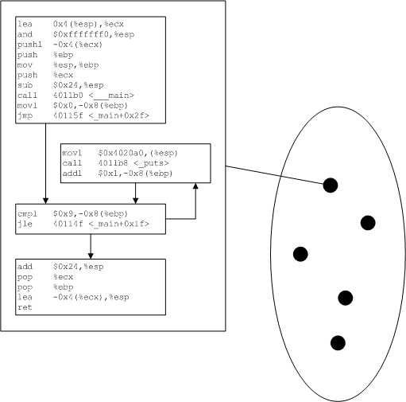
Simseer Program Fingerprint
Set of control flow graphs
Many procedures

Slide 9
DEMO - Binalyze

Slide 10
Decompilation of a Control Flow Graph

Slide 11
Q-Grams
Input is decompiled strings
Extract all possible fixed size substrings (q-grams)
Train 500 dominant q-grams

Slide 12
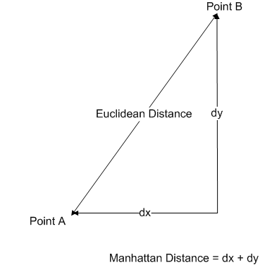
Program Similarity
500 q-grams make a ‘feature vector’
Similarity using vector distance

Slide 13
Software similarity search

Slide 14
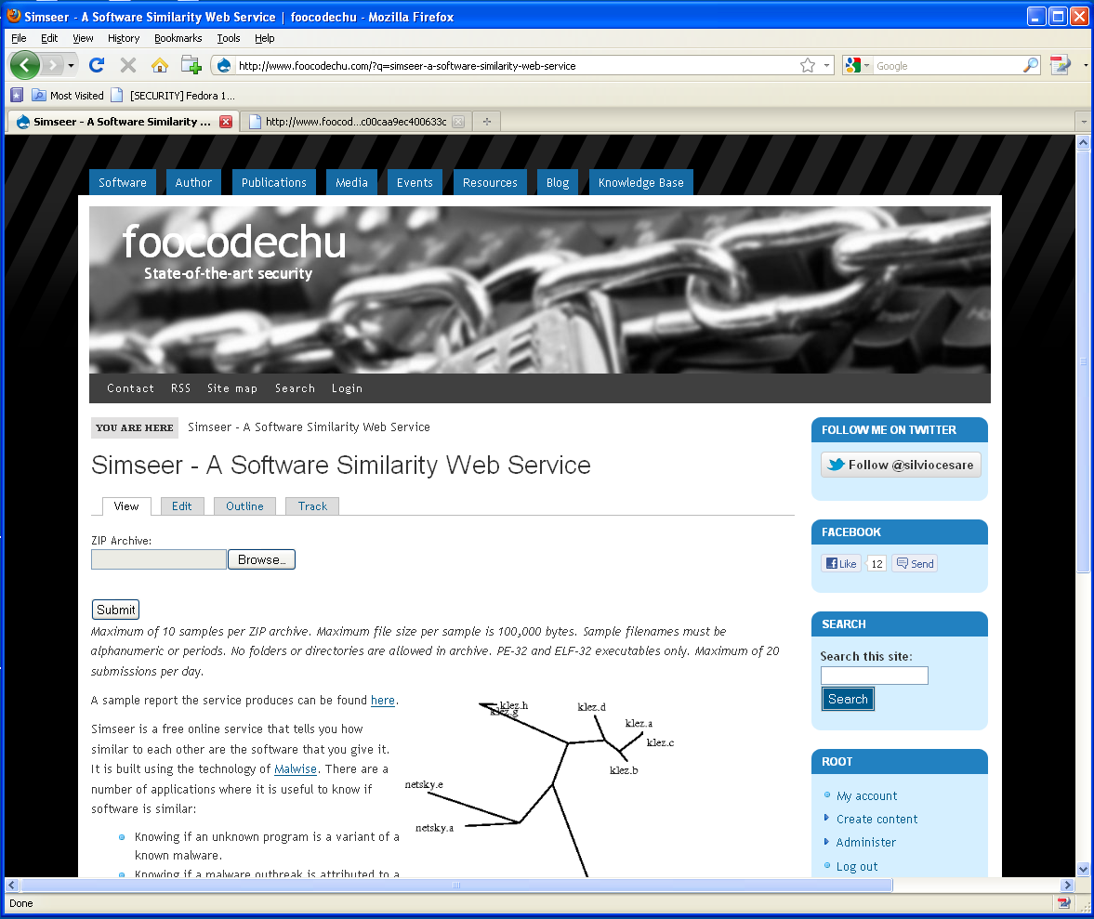

Slide 15
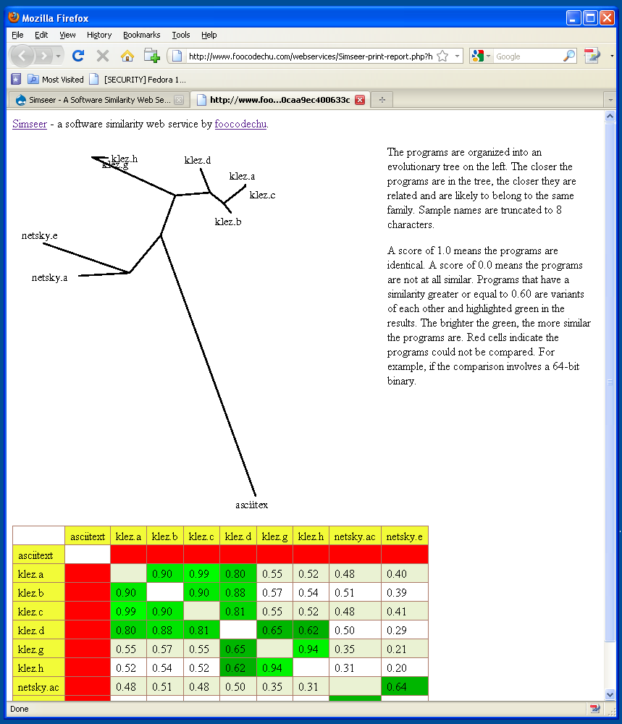

Slide 16
DEMO - Simseer

Slide 17
Future Work
Give access to more classes of program ‘fingerprints’
Call graphs
Opcodes
Different similarity measures

Slide 18
Simseer summary
Simseer is effective
Efficient
Web service is free for public use

Slide 19
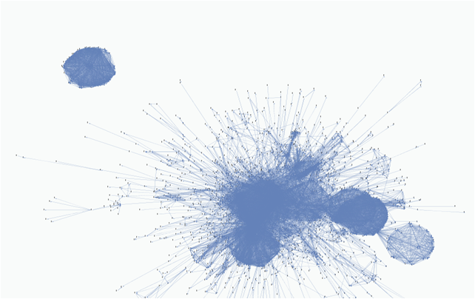
Clonewise
Detecting package clones and inferring security problems

Slide 20
Motivation
Developers may “embed” or “clone” software from 3rd party sources
Maintaining an internal copy of a library
Forking a library
Clonewise detects if two packages share code
And if one package is entirely embedded in another.

Slide 21
Feature Extraction – Shared package clone detection
N_Filenames_A
N_Filenames_Source_A
N_Filenames_B
N_Filenames_Source_B
N_Common_Filenames
N_Common_Similar_Filenames
N_Common_FilenameHashes
N_Common_FilenameHash80
N_Common_ExactFilenameHash
N_Score_of_Common_Filename
N_Score_of_Common_Similar_Filename
N_Score_of_Common_FilenameHash
N_Score_of_Common_FilenameHash80
N_Score_of_Common_ExactFilenameHash80
N_Data_Common_Filenames
N_Data_Common_Similar_Filenames
N_Data_Common_FilenameHashes
N_Data_Common_FilenameHash80
N_Data_Common_ExactFilenameHash
N_Data_Score_of_Common_Filename
N_Data_Score_of_Common_Similar_Filename
N_Data_Score_of_Common_FilenameHash
N_Data_Score_of_Common_FilenameHash80
N_Data_Score_of_Common_ExactFilenameHash80
N_Common_ExactHash
N_Common_DataExactHash

Slide 22
Classification
Consider feature vectors as n-dimensional points in space.
Linear classifiers
Non-linear classifiers
Decision trees

Slide 23
Feature Extraction – Embedded clone detection
N_Filenames_A
N_Filenames_Source_A
N_Filenames_B
N_Filenames_Source_B
Percent_Match_In_A
Percent_Data_Match_In_A
Percent_Match_In_B
Percent_Data_Match_In_B
Percent_Score_In_A
Percent_Data_Score_In_A
Percent_Score_In_B
Percent_Data_Score_In_B
A_Has_Lib_In_Name
B_Has_Lib_In_Name
A_To_B_Ratio
A_To_B_Data_Ratio
N_Dependents_A
N_Dependents_B

Slide 24
Detecting copyright violations
Identify embedded package clones.
Extract license information of each package.
For each GPL licensed embedded package clone:
Verify that the package it is embedded in is not licensing it under a permissive license.

Slide 25
Automated Vulnerability Inference
Take CVE, match CPE name to Debian package.
Parse CVE summary and extract vuln filename.
Find clones of package with similar filename.
Trim dynamically linked clones.
Is vuln affected clone already being tracked?

Slide 26
Package clone detection use-case

Slide 27
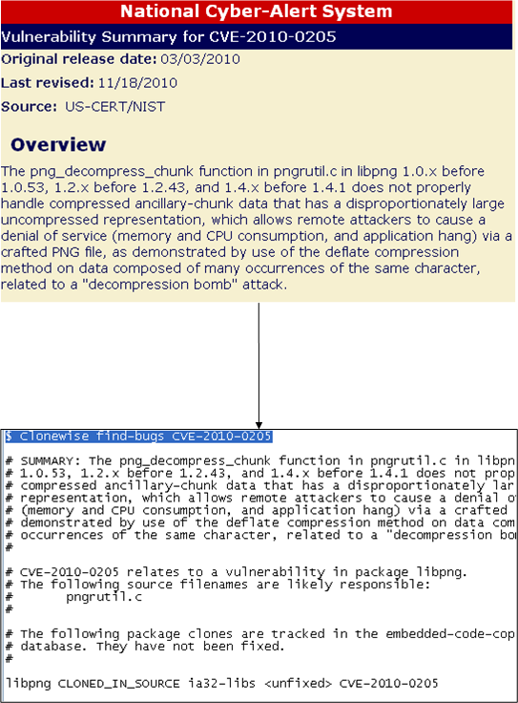
Finding Vulnerabilities

Slide 28
Shared package clone evaluation
Classifier | TP/FN | FP/TN | TP Rate | FP Rate
Naïve Bayes | 439/322 | 484/56296 | 57.69% | 0.85%
Multilayer Perceptron | 204/557 | 48/56732 | 26.81% | 0.08%
C4.5 | 523/238 | 86/56694 | 68.73% | 0.15%
Random Forest | 533/228 | 60/56720 | 70.04% | 0.11%
Random Forest (0.8) | 446/315 | 15/56765 | 58.61% | 0.03%

Slide 29
Embedded clone detection evaluation
Classifier | TP/FN | FP/TN | TP Rate | FP Rate
Naïve Bayes | 718/43 | 6341/2808 | 94.35% | 69.31%
Multilayer Perceptron | 328/433 | 108/9041 | 43.10% | 1.18%
C4.5 | 572/189 | 69/9080 | 75.16% | 0.75%
Random Forest | 554/207 | 68/9081 | 72.80% | 0.74%
Asymmetric Bagging | 699/62 | 615/8534 | 91.86% | 6.72%

Slide 30
Automatic detection of suspicious clones
Package | Embedded Package
freevo | feedparser
hedgewars | freetype
ia32-libs | *
libtk-img | tiff
likewise-open | curl
luatex | poppler
planet-venus | feedparser
syslinux | libpng
vnc4 | freetype
vtk | tiff

Slide 31
DEMO - Clonewise

Slide 32
Future Work
Binary-level clone detection
Integrate into Linux distributions
Linux security teams usage

Slide 33
Clonewise summary
Practical clone detection in Linux
Improves manual only tracking
Has found bugs
Debian Linux want to integrate it into infrastructure
Open source project
Web service to perform clone detection

Slide 34
Bugwise
Detecting bugs in binaries using decompilation and data flow analysis

Slide 35
Motivation
Detecting bugs in binary is useful
Black-box penetration testing
External audits and compliance
Quality assurance of 3rd party software
Verification of compilation and linkage

Slide 36
Wire – A formal language for binary analysis
x86 is complex and big
Wire is a low level RISC assembly style language
Translated from x86
Formally defined operational semantics
The LOAD instruction implements a memory read.

Slide 37
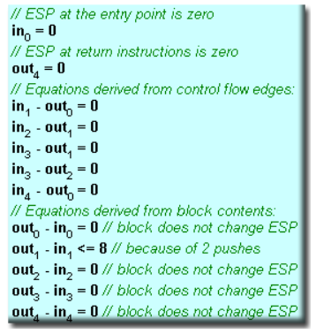
Stack Pointer Inference
Proposed in HexRays decompiler - http://www.hexblog.com/?p=42
Estimate Stack Pointer (SP) in and out of basic block
By tracking and estimating SP modifications using linear inequalities
Solve.
Picture from HexRays blog.

Slide 38
Decompilation - Local Variable Recovery
Based on stack pointer inference
Access to memory offset to the stack
Replace with native Wire register
Imark ($0x80483f5, , )
AddImm32 (%esp(4), $0x1c, %temp_memreg(12c))
LoadMem32 (%temp_memreg(12c), , %temp_op1d(66))
Imark ($0x80483f9, , )
StoreMem32(%temp_op1d(66), , %esp(4))
Imark ($0x80483fc, , )
SubImm32 (%esp(4), $0x4, %esp(4))
LoadImm32 ($0x80483fc, , %temp_op1d(66))
StoreMem32(%temp_op1d(66), , %esp(4))
Lcall (, , $0x80482f0)
Imark ($0x80483f5, , )
Imark ($0x80483f9, , )
Imark ($0x80483fc, , )
Free (%local_28(186bc), , )
→

Slide 39
Data Flow Analysis - Reaching Definitions
A reaching definition is a definition of a variable that reaches a program point without being redefined.

Slide 40
More data flow problems
Upward Exposed Uses
All uses of a definition
Live Variables
A variable is live if it will be subsequently read without being redefined.
Reaching Copies
The reach of a copy statement
etc

Slide 41
getenv() bugs
Detect unsafe applications of getenv()
Example: strcpy(buf,getenv(“HOME”))
For each getenv()
If return value is live
And it’s the reaching definition to the 2nd argument to strcpy()
Then warn
P.S. 2001 wants its bugs back.

Slide 42
Use-after-free Detection
For each free(ptr)
If ptr live
Then warn
void f(int x)
{
int *p = malloc(10);
dowork(p);
free(p);
if (x)
p[0] = 1;
}

Slide 43
Double Free Detection
For each free(ptr)
If an upward exposed use of ptr’s definition is free(ptr)
Then warn
2001 calls again
void f(int x)
{
int *p = malloc(10);
dowork(p);
free(p);
if (x)
free(p);
}

Slide 44
getenv() bugs
Scanned entire Debian 7 unstable repository
~123,000 ELF binaries
85 bug reports
47 packages
4digits | ptop
acedb-other-belvu | recordmydesktop
acedb-other-dotter | rlplot
bvi | sapphire
comgt | sc
csmash | scm
elvis-tiny | sgrep
fvwm | slurm-llnl-slurmdbd
garmin-ant-downloader | statserial
gcin | stopmotion
gexec | supertransball2
gmorgan | theorur
gopher | twpsk
gsoko | udo
gstm | vnc4server
hime | wily
le-dico-de-rene-cougnenc | wmpinboard
libreoffice-dev | wmppp.app
libxgks-dev | xboing
lie | xemacs21-bin
lpe | xjdic
mp3rename | xmotd
mpich-mpd-bin
open-cobol
procmail

Slide 45
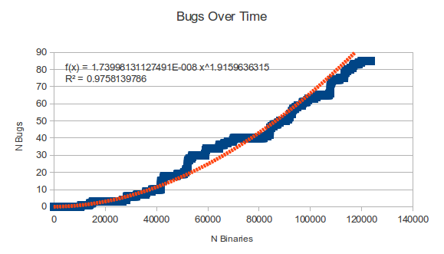
getenv() bugs over time – sorted by binary size
Linear or power growth?

Slide 46
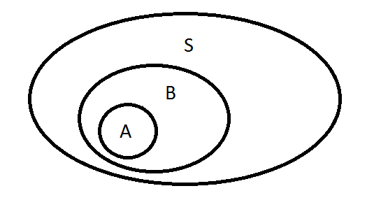
getenv() bug statistics
Probability (P) of a binary being vulnerable: 0.00067
P. of a package being vulnerable: 0.00255
P. of a package having a 2nd vulnerability given that one binary in the package is vulnerable: 0.52380
Conditional probability of A given that B has occurred:

Slide 47
DEMO - Bugwise

Slide 48
Double free in SGID games “xonix”
memset(score_rec[i].login, 0, 11);
strncpy(score_rec[i].login, pw->pw_name, 10);
memset(score_rec[i].full, 0, 65);
strncpy(score_rec[i].full, fullname, 64);
score_rec[i].tstamp = time(NULL);
free(fullname);
if((high = freopen(PATH_HIGHSCORE, "w",high)) == NULL) {
fprintf(stderr, "xonix: cannot reopen high score file\n");
free(fullname);
gameover_pending = 0;
return;
}

Slide 49
Future Work
Core
Summary-based interprocedural analysis
Context sensitive interprocedural analysis
Pointer analysis
Improved decompilation
More bug classes

Slide 50
Bugwise summary
Practical tool to find simple bugs
Based on strong theory
Extensible
Much work to do in the future
Web service free to use

Slide 51
Future Work and Conclusion

Slide 52
Future Work
Make more of my research public
Provide better backend infrastructure
Get people to use the services!

Slide 53
Conclusion
All of the tools in this talk are for public use
http://www.FooCodeChu.com
Wiki on software similarity and classification
Preprint of my book available
Buy my book from Springer

